Slide 1
Basic of Artificial Neural Network
Team Ignite
Saachi Yadav
Ankita mandal
diya maniyar

Slide 2
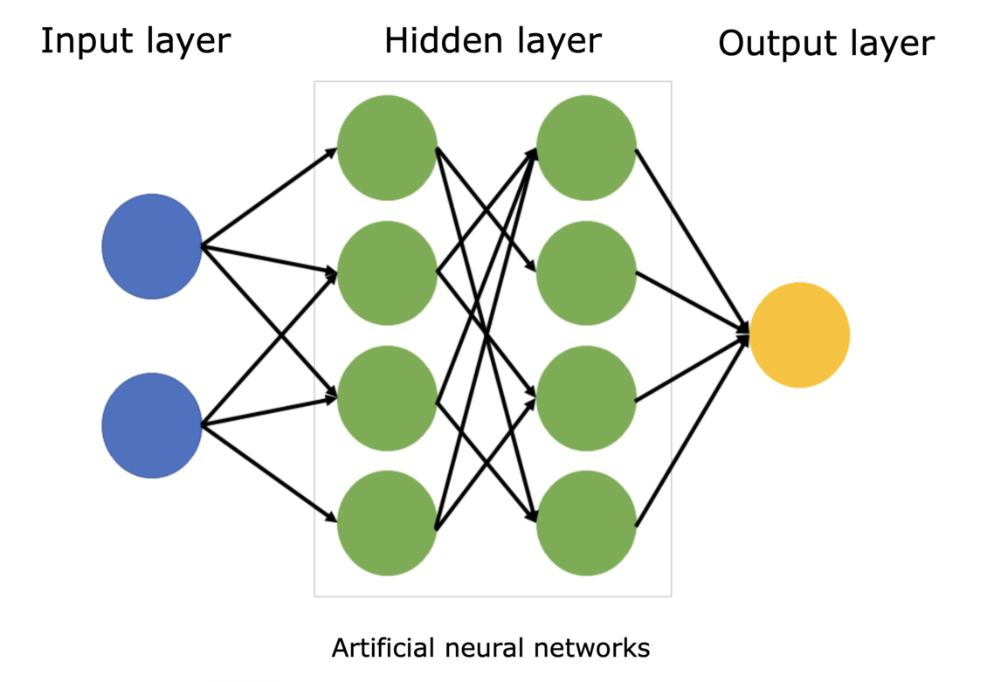
Introduction to Artificial Neural Networks (ANN)
ANN are inspired by the human brain and mimic its way of processing information. They consist of interconnected processing elements (neurons) that work together to solve problems. ANN learn from examples and adjust their connections, similar to how humans learn.

Slide 3
Key Features of ANN
Adaptive Learning: Learns from experience and data provided for training.
Self-Organization: Can arrange and represent information on its own.
Real-Time Processing: Capable of handling computations in parallel for faster performance.
Fault Tolerance: Can still function even if some parts of the network are damaged.

Slide 4
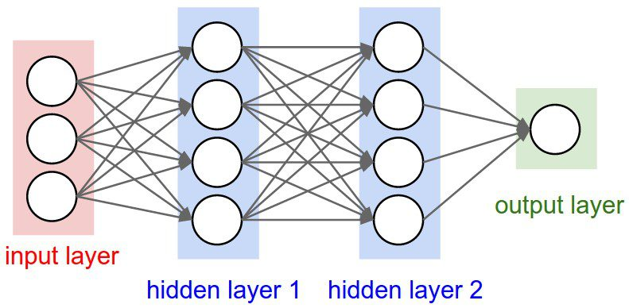
How ANN Works
ANN are structured in layers:
Input Layer: Receives raw data from external sources.
Hidden Layers: Process the data and extract patterns.
Output Layer: Provides the final result or classification.

Slide 5
Training Methods of ANN UNSupervised and supervised Learning
Unsupervised
supervised
Supervised training involves a mechanism of providing the network with the desired output either by manually "grading" the network's performance or by providing the desired outputs with the inputs.
If a network simply can't solve the problem, the designer then has to review the input and outputs and the number of layers. Those changes required to create a successful network is where the hard work is required.
The network is given input data along with the correct output. It adjusts itself based on errors and improves accuracy over time. Used in applications like handwriting recognition and medical diagnosis.
This is often referred to as self organization or adaption

Slide 6
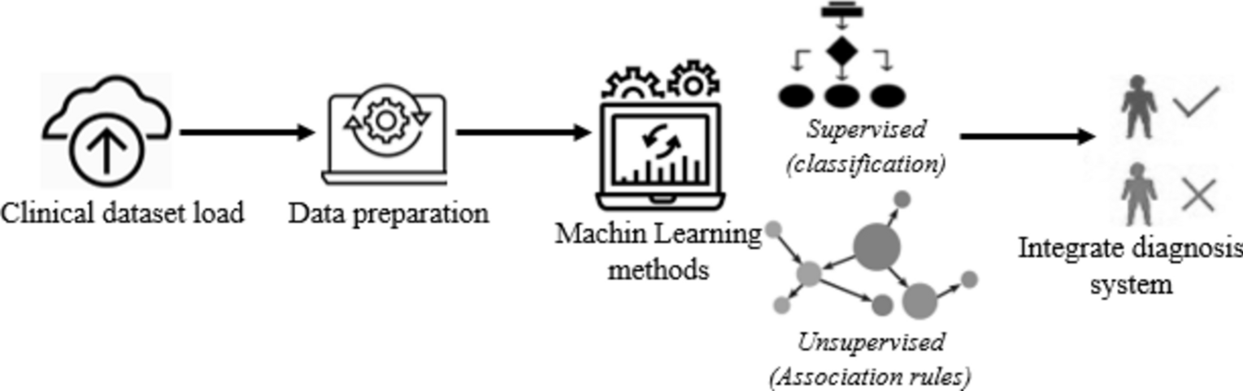
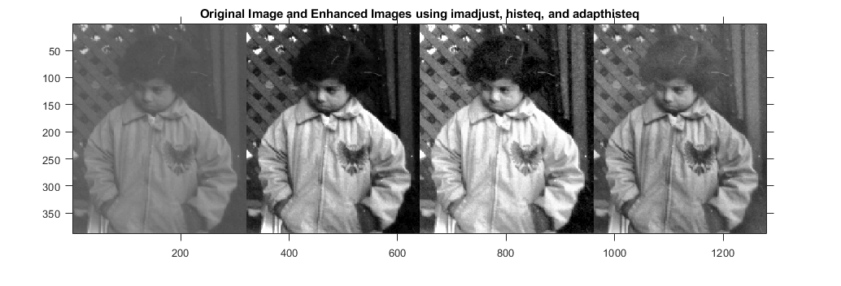
Applications of ANN
Pattern Recognition: Face recognition, fingerprint scanning, speech recognition.
Medical Diagnosis: Identifying diseases based on medical records.
Financial Analysis: Stock market prediction, fraud detection.
Control Systems: Autonomous vehicles, industrial automation.
Data Processing: Image enhancement, voice filtering, spam detection.

Slide 7
Advantages of ANN
Can handle complex, nonlinear relationships between data.
Do not require strict rules like traditional programming.
Work well in dynamic environments where data keeps changing.
Can generalize from past data to make predictions about new situations.

Slide 8
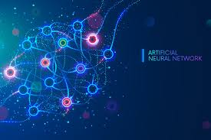
CONCLUSION
ANNs are powerful tools that provide an alternative to traditional computing. They can solve problems that are difficult for conventional algorithms. Their future depends on advancements in hardware for faster and more efficient processing.

Slide 9
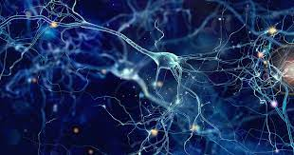
THANK YOU!

